Slide 1
An Introduction to the Multichannel Rendezvous Problem-Part II
Prof. Cheng-Shang Chang (張正尚教授)
Institute of Communications Engineering National Tsing Hua University
July 2025

Slide 2
The sym/async/homo/global MRP
The two users are symmetric.
Their clocks may not be synchronized.
Both users share the same available channel set; that is, all 𝑁 channels are available to both.
The 𝑁 channels are globally labeled.

Slide 3
Sawtooth sequences (Yang, D., J. S., C. Kim. 2010. Deterministic rendezvous scheme in multichannel access networks. (DRSEQ) Electronics Letters 46(20) 1402-1404.)
f(t) is “periodic,” but it is not specified for any t that is an integer multiple of 2n+1.
A sawtooth sequence of order 4 is

Slide 4
Properties of a sawtooth sequence
Suppose f(t) is a sawtooth sequence of order n. Consider two sequences x₁(t)=f(t) and x₂(t)=f(t+d). Then for any time shift d,

Slide 5


Sawtooth sequence
4
3
2
1
0

Slide 6


Two users who follow the same sawtooth sequence will rendezvous within the period
Case 1: they rendezvous during the first half period.
4
3
2
1
0

Slide 7

Case 2: they rendezvous during the second half of the period (one user needs to change its phase when it reaches the bottom)
4
3
2
1
0

Slide 8
The sym/async/homo/global MRP
DRSEQ only rendezvous on a particular channel for a specific clock drift d.
Maximum degree of overlapping (maximum rendezvous diversity): we would like to construct channel hopping sequences that rendezvous on every channel of the N channels in the period.

Slide 9
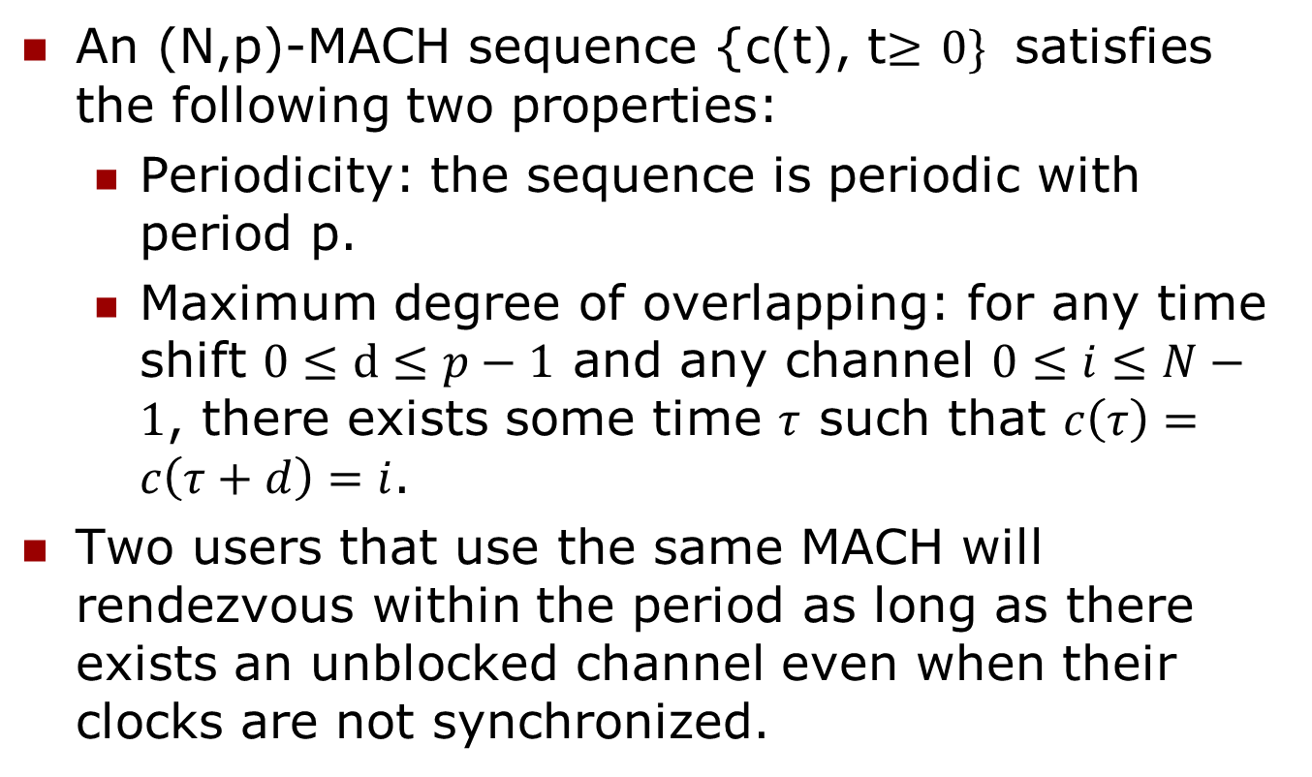
Asynchronous channel hopping sequence with maximum degree of overlapping (rendezvous diversity)
An (N,p)-MACH sequence {c(t), t$≥$ $0\}$ satisfies the following two properties:
  Periodicity: the sequence is periodic with period p.
  Maximum degree of overlapping: for any time shift $0≤d≤p−1$ and any channel $0≤i≤N−1$, there exists some time $τ$ such that $c\left(τ\right)=c\left(τ+d\right)=i$.
Two users that use the same MACH will rendezvous within the period as long as there exists an unblocked channel even when their clocks are not synchronized.

Slide 10
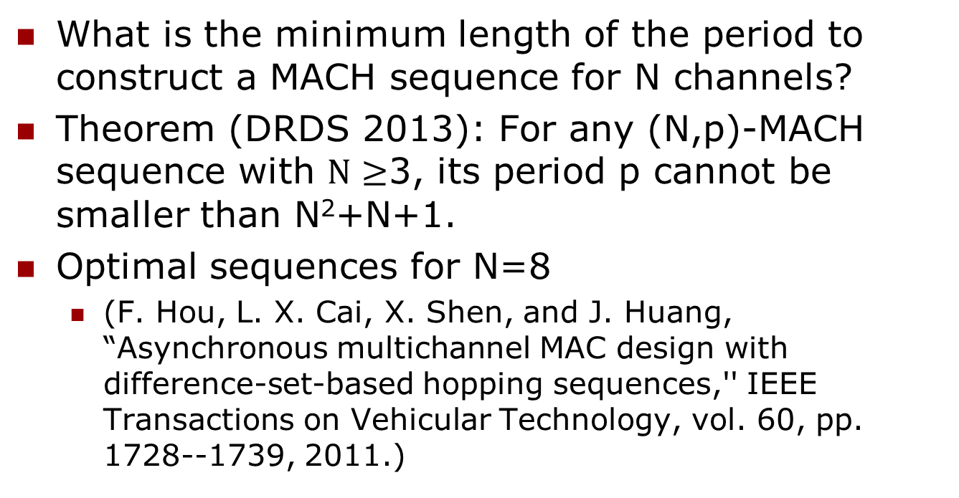
Asynchronous channel hopping sequence with maximum degree of overlapping
What is the minimum length of the period to construct a MACH sequence for N channels?
Theorem (DRDS 2013): For any (N,p)-MACH sequence with $N≥$3, its period p cannot be smaller than N²+N+1.
Optimal sequences for N=8
  (F. Hou, L. X. Cai, X. Shen, and J. Huang, “Asynchronous multichannel MAC design with difference-set-based hopping sequences,'' IEEE Transactions on Vehicular Technology, vol. 60, pp. 1728--1739, 2011.)

Slide 11
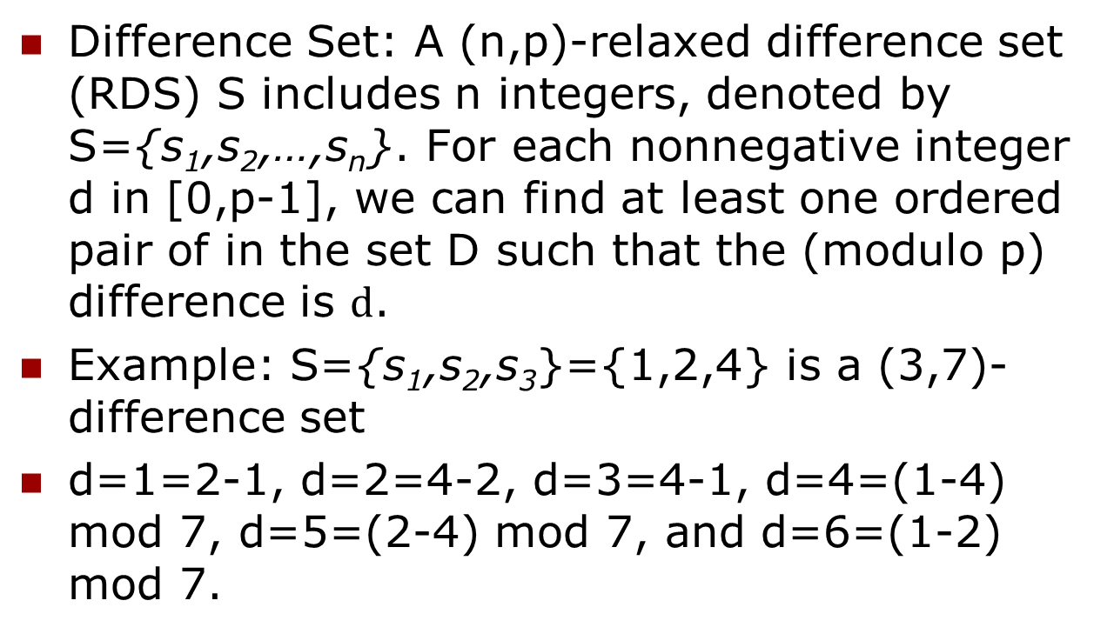
Packing disjoint difference sets
Difference Set: A (n,p)-relaxed difference set (RDS) S includes n integers, denoted by S={s₁,s₂,…,s_{n}}. For each nonnegative integer d in [0,p-1], we can find at least one ordered pair of in the set D such that the (modulo p) difference is $d$.
Example: S={s₁,s₂,s₃}={1,2,4} is a (3,7)-difference set
d=1=2-1, d=2=4-2, d=3=4-1, d=4=(1-4) mod 7, d=5=(2-4) mod 7, and d=6=(1-2) mod 7.

Slide 12
S={1,2,4} is a (3,7)-perfect difference set
0 | 1 | 2 | 3 | 4 | 5 | 6 | 7 | 8 | 9 | 10 | 11 | 12 | 13
d=1
d=2
d=3

Slide 13
Perfect difference set
A (n,p)-perfect difference set can be visualized as a dot pattern that has a dot on the coordinate of an element.
Repeat the dot pattern infinitely often in the line. Then for any time shift, exactly one pair of dots will overlap in every period of p.

Slide 14
Packing 8 disjoint (8,73)-perfect difference sets to construct a (8,73)-MACH on 8 channels

Slide 15
Some other well-known MACH sequences
CRSEQ 2010: (N, N(3N-1))-MACH sequence
JS 2011
DRDS 2013: (N, 3N²)-MACH sequence
T-CH 2015: (N, 2.5N²)-MACH sequence
DSCR 2016: (N, 2.5N²)-MACH sequence

Slide 16
Asymptotically optimal MACH
The asymptotic approximation ratio, defined as the ratio of the period to the lower bound N² when N goes to infinity, is still 2.5 for T-CH, 3 for CRSEQ, DRDS, and DSCR.
One of the open questions in the multichannel rendezvous problem is whether it is possible to construct a periodic CH sequence that has the asymptotic approximation ratio 1. Such CH sequences are called asymptotically optimal CH sequences.
The IDEAL-CH that has the asymptotic approximation ratio 2.

Slide 17
IDEAL-CH
Cheng-Shang Chang, Jang-Ping Sheu, and Yi-Jheng Lin,"On the theoretical gap of channel hopping sequences with maximum rendezvous diversity in the multichannel rendezvous problem," IEEE/ACM Transactions on Networking, vol. 29, no. 4, pp. 1620--1633, Aug. 2021.
Ideal matrix
semi-MACH matrix
MACH matrix
MACH sequence

Slide 18
IDEAL-CH
MACH sequences and matrices
Difference sets
Ideal matrices
From an ideal matrix to a semi-MACH matrix
From a semi-MACH matrix to an MACH matrix
From an MACH matrix to an MACH sequence

Slide 19
IDEAL-CH
MACH sequences and matrices
Difference sets
Ideal matrices
From an ideal matrix to a semi-MACH matrix
From a semi-MACH matrix to an MACH matrix
From an MACH matrix to an MACH sequence

Slide 20
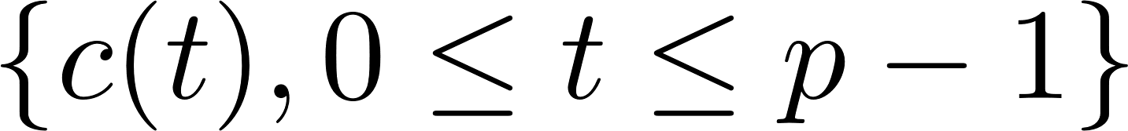
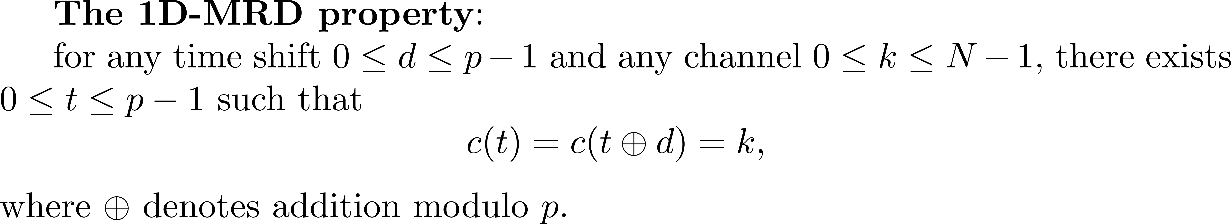
MACH sequences and matrices
MACH sequence: Asynchronous Channel Hopping sequence with Maximum rendezvous diversity.
Definition: An (N, p)-MACH sequence
satisfies the following one dimensional maximum rendezvous diversity (1D-MRD) property:

Slide 21


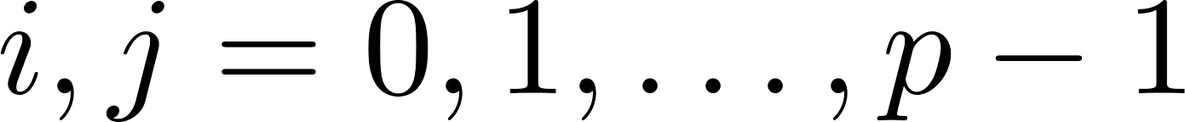
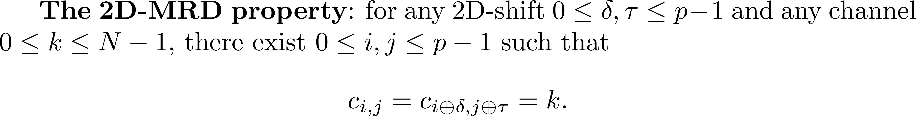

MACH sequences and matrices
Definition : A matrix with
is called an (N, p)-MACH matrix if it satisfies the following two-dimensional maximum rendezvous diversity (2D-MRD) property:
A weaker version of an (N, p)-MACH matrix is called an (N, p)-semi-MACH matrix, in which the 2D-MRD property may not be satisfied for

Slide 22
MACH sequences and matrices
In our construction, there are two elegant mathematical tools for dealing with circular shifts:
  perfect difference sets
  ideal matrices

Slide 23
IDEAL-CH
MACH sequences and matrices
Difference sets
Ideal matrices
From an ideal matrix to a semi-MACH matrix
From a semi-MACH matrix to an MACH matrix
From an MACH matrix to an MACH sequence

Slide 24
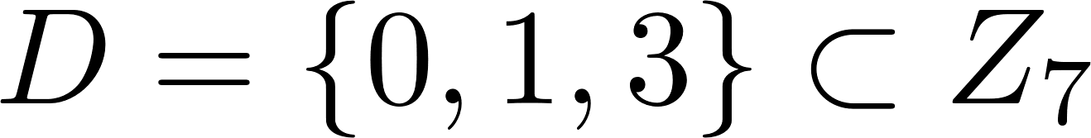
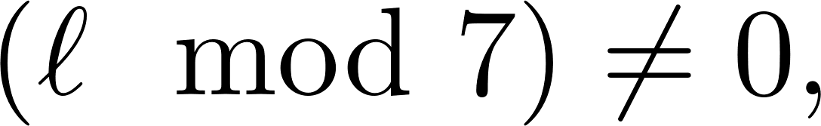
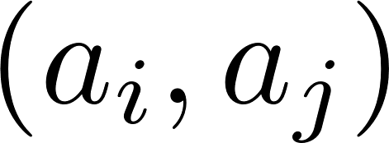
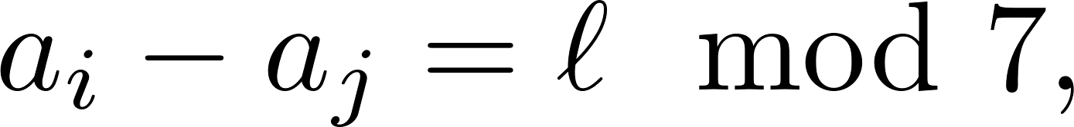
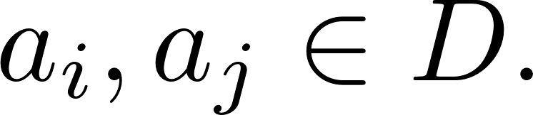
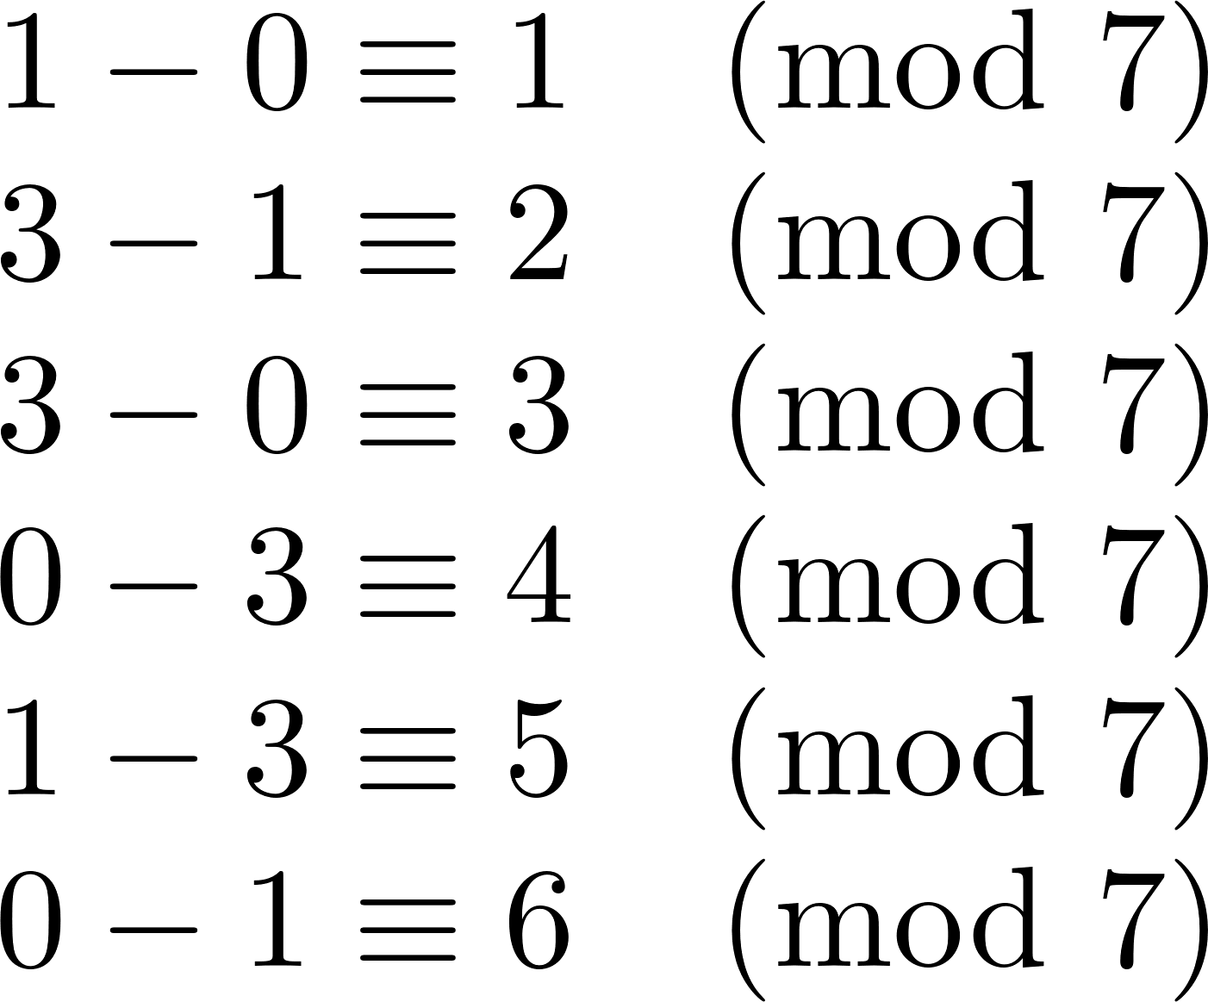
Difference sets
Example: is a (7, 3, 1)-perfect difference set, i.e., for every
there exists exactly one ordered pair such that
where

Slide 25
Difference sets
Example: is a (7, 3, 1)-perfect difference set.
 | 0 | 1 | 2 | 3 | 4 | 5 | 6
d=0 | 0 | 1 |  | 3
d=1 |  | 1 | 2 |  | 4
d=2 |  |  | 2 | 3 |  | 5
d=3 |  |  |  | 3 | 4 |  | 6
d=4 | 0 |  |  |  | 4 | 5
d=5 |  | 1 |  |  |  | 5 | 6
d=6 | 0 |  | 2 |  |  |  | 6

Slide 26
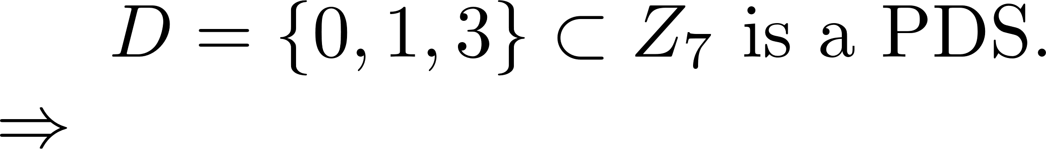
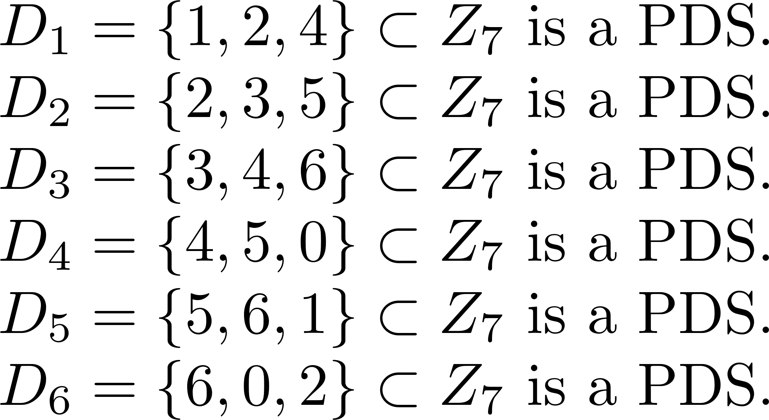
Difference sets
The rotation property of a perfect difference set:

Slide 27
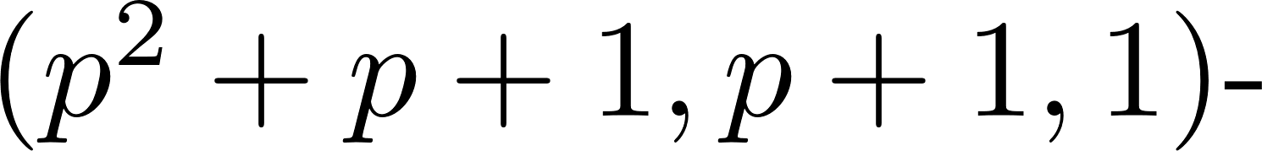
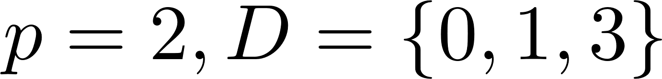
Difference sets
There is an explicit construction of
perfect difference set for any p that is a prime power.
For example, for is a (7, 3, 1)-perfect difference set.

Slide 28
IDEAL-CH
MACH sequences and matrices
Difference sets
Ideal matrices
From an ideal matrix to a semi-MACH matrix
From a semi-MACH matrix to an MACH matrix
From an MACH matrix to an MACH sequence

Slide 29
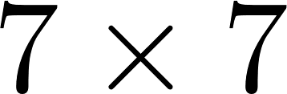
Ideal matrices
Example: A ideal matrix (0-1 binary matrix).
 |  |  | 1
 |  | 1 |  | 1
 | 1 |  |  |  | 1
1 |  |  |  |  |  | 1

Slide 30


 |  |  | 1 |  |  |  |  |  |  | 1
 |  | 1 |  | 1 |  |  |  |  | 1 |  | 1
 | 1 |  |  |  | 1 |  |  | 1 |  |  |  | 1
1 |  |  |  |  |  | 1 | 1 |  |  |  |  |  | 1
 |  |  | 1 |  |  |  |  |  |  | 1
 |  | 1 |  | 1 |  |  |  |  | 1 |  | 1
 | 1 |  |  |  | 1 |  |  | 1 |  |  |  | 1
1 |  |  |  |  |  | 1 | 1 |  |  |  |  |  | 1
 |  |  | 1
 |  | 1 |  | 1
 | 1 |  |  |  | 1
1 |  |  |  |  |  | 1

Slide 31

 |  |  | 1 |  |  |  |  |  |  | 1
 |  | 1 |  | 1 |  |  |  |  | 1 |  | 1
 | 1 |  |  |  | 1 |  |  | 1 |  |  |  | 1
1 |  |  |  |  |  | 1 | 1 |  |  |  |  |  | 1
 |  |  | 1 |  |  |  |  |  |  | 1
 |  | 1 |  | 1 |  |  |  |  | 1 |  | 1
 | 1 |  |  |  | 1 |  |  | 1 |  |  |  | 1
1 |  |  |  |  |  | 1 | 1 |  |  |  |  |  | 1
 |  |  | 1
 |  | 1 |  | 1
 | 1 |  |  |  | 1
1 |  |  |  |  |  | 1

Slide 32

 |  |  | 1 |  |  |  |  |  |  | 1
 |  | 1 |  | 1 |  |  |  |  | 1 |  | 1
 | 1 |  |  |  | 1 |  |  | 1 |  |  |  | 1
1 |  |  |  |  |  | 1 | 1 |  |  |  |  |  | 1
 |  |  | 1 |  |  |  |  |  |  | 1
 |  | 1 |  | 1 |  |  |  |  | 1 |  | 1
 | 1 |  |  |  | 1 |  |  | 1 |  |  |  | 1
1 |  |  |  |  |  | 1 | 1 |  |  |  |  |  | 1
 |  |  | 1
 |  | 1 |  | 1
 | 1 |  |  |  | 1
1 |  |  |  |  |  | 1

Slide 33
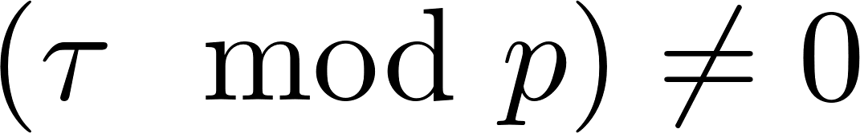
Ideal matrices
A binary (0,1) ideal matrix has the following three important properties:
  (No shift) If all dots overlap.
  (Purely vertical shifts) If
  no dot will overlap.
  (The other shifts) For any other shifts, i.e.,
  exactly one pair of dots will overlap.
A ideal matrix M can be constructed when p is a prime. (The Elliot-Butson construction)

Slide 34
IDEAL-CH
MACH sequences and matrices
Difference sets
Ideal matrices
From an ideal matrix to a semi-MACH matrix
From a semi-MACH matrix to an MACH matrix
From an MACH matrix to an MACH sequence

Slide 35
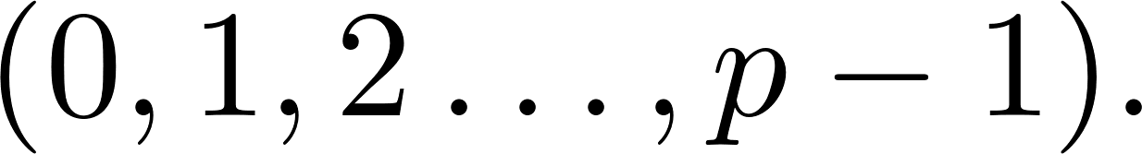
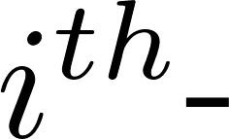
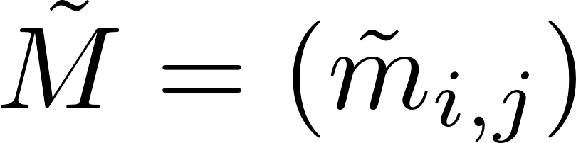

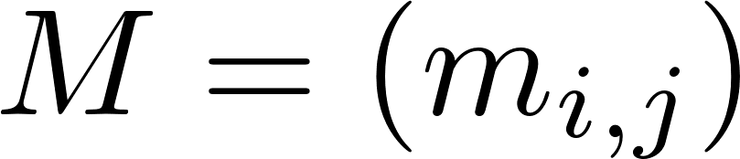
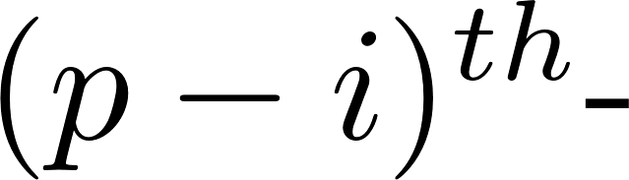
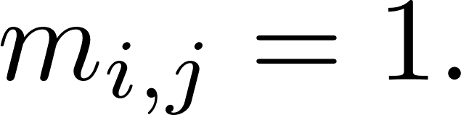
From an ideal matrix to a semi-MACH matrix
To construct a semi-MACH matrix from an ideal matrix, the idea is to replace each column of an ideal matrix by a permutation of
Specifically, define the rotation to be the permutation
Construct a matrix by replacing the
column of a ideal matrix by the
rotation if

Slide 36
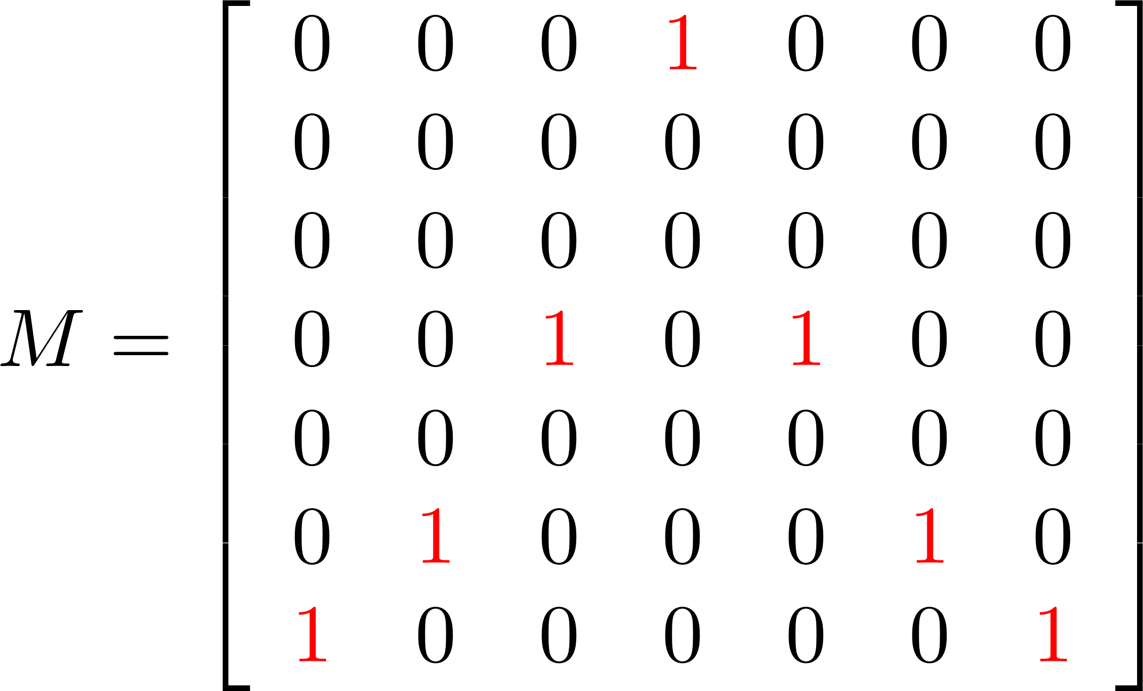
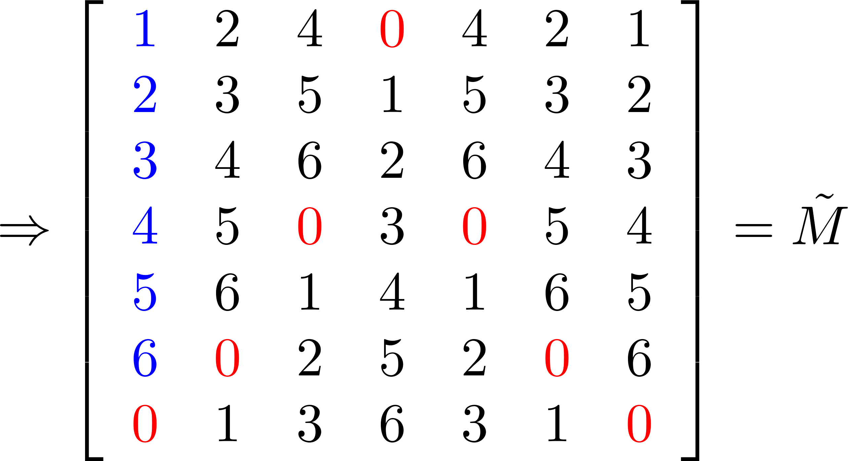

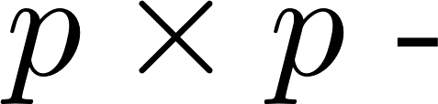
From an ideal matrix to a semi-MACH matrix
Example: the conversion for the ideal matrix:
The matrix is a semi-MACH matrix that satisfies the 2D-MRD property except purely vertical shifts.

Slide 37
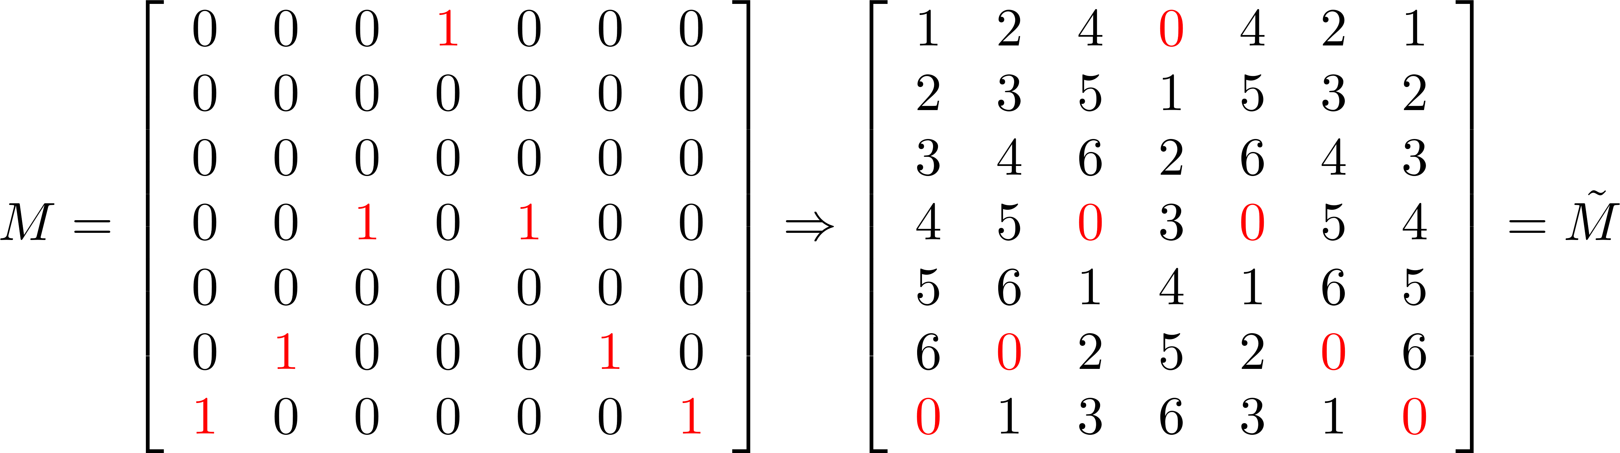

Slide 38
IDEAL-CH
MACH sequences and matrices
Difference sets
Ideal matrices
From an ideal matrix to a semi-MACH matrix
From a semi-MACH matrix to an MACH matrix
From an MACH matrix to an MACH sequence

Slide 39
From a semi-MACH matrix to an MACH matrix
Question: How to deal with the problem of purely vertical shifts?
Our idea: Reserve some channels of the p channels for embedding perfect difference sets.
reserve p+1 channels for PDS

Slide 40
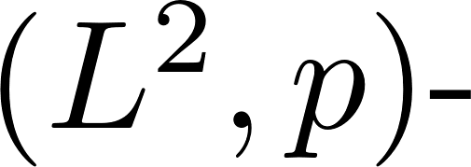
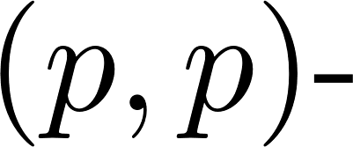
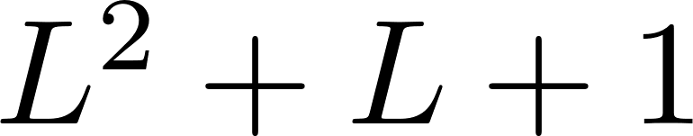
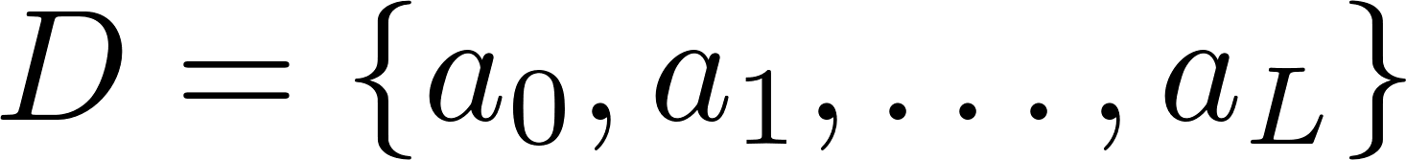
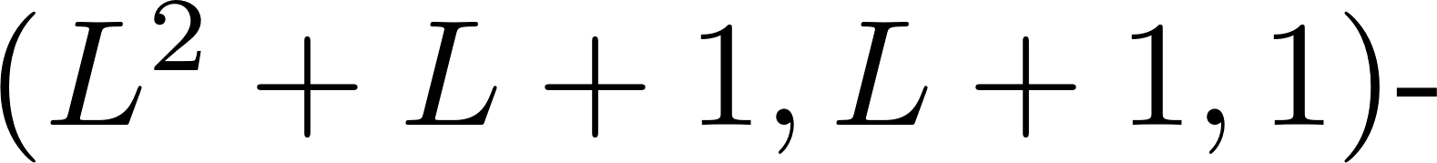
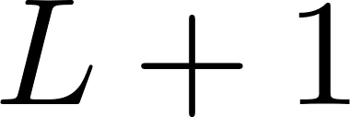
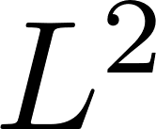

From a semi-MACH matrix to an MACH matrix
Construct an MACH matrix from a semi-MACH matrix when p is a prime and p is equal to
for some prime power L.
Let be an
perfect difference set and be a semi-MACH matrix.
Let
Reserve the channels in D for the perfect difference sets and only use the channels in

Slide 41
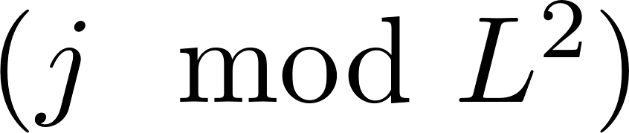
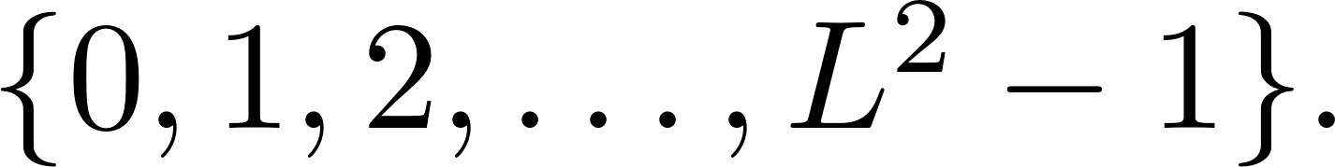
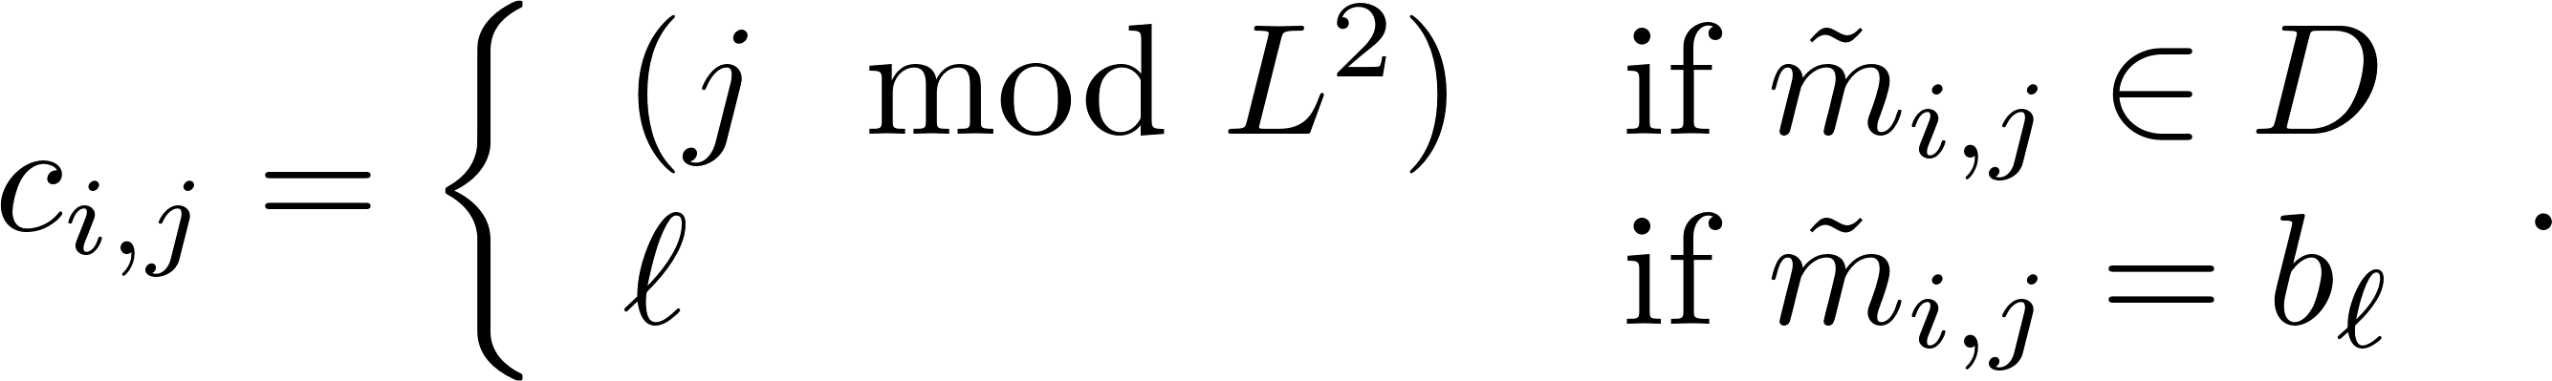
From a semi-MACH matrix to an MACH matrix
The channels in D in the column of are replaced by channel and the other channels are re-mapped to the channels in
Specifically, we construct a matrix by the following rule:

Slide 42
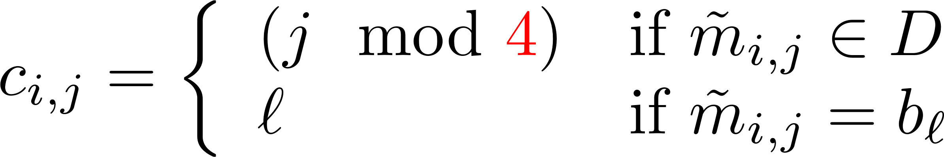
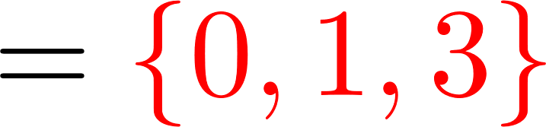
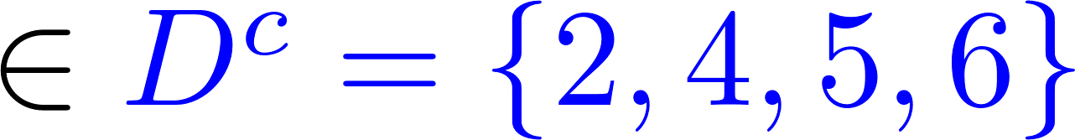
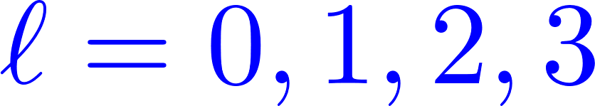
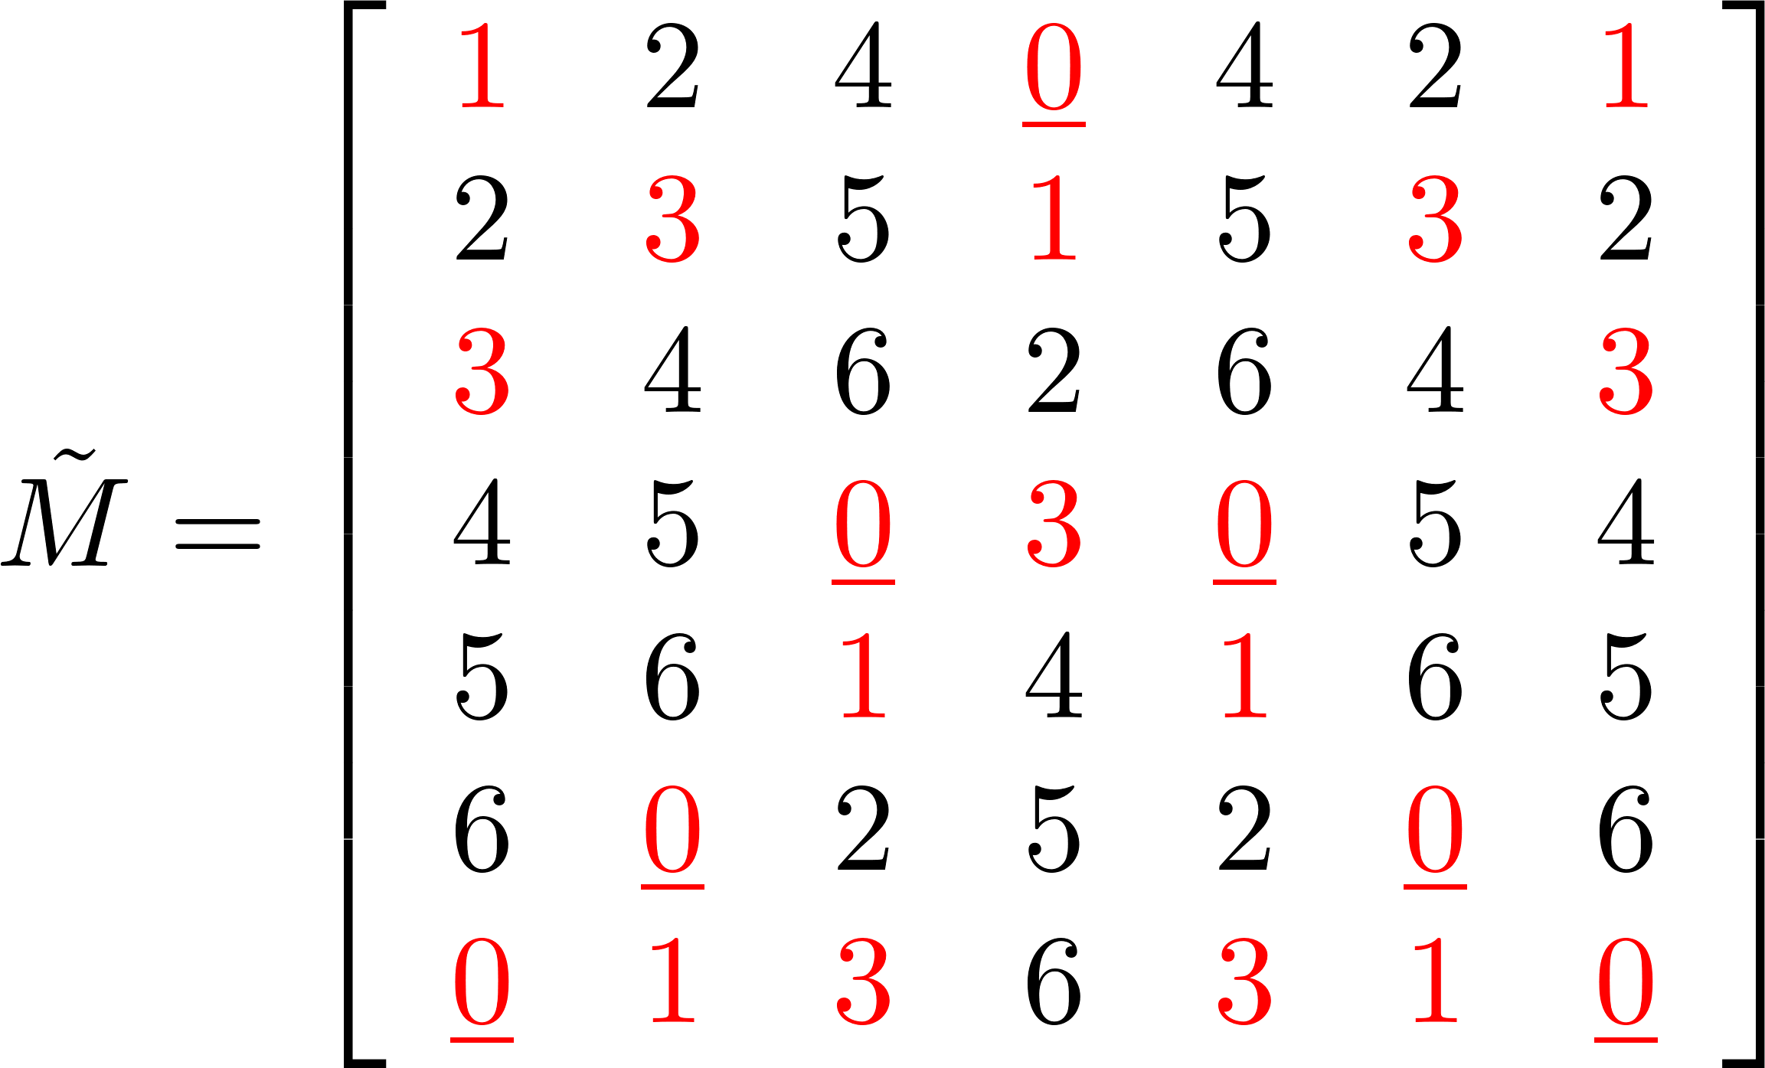
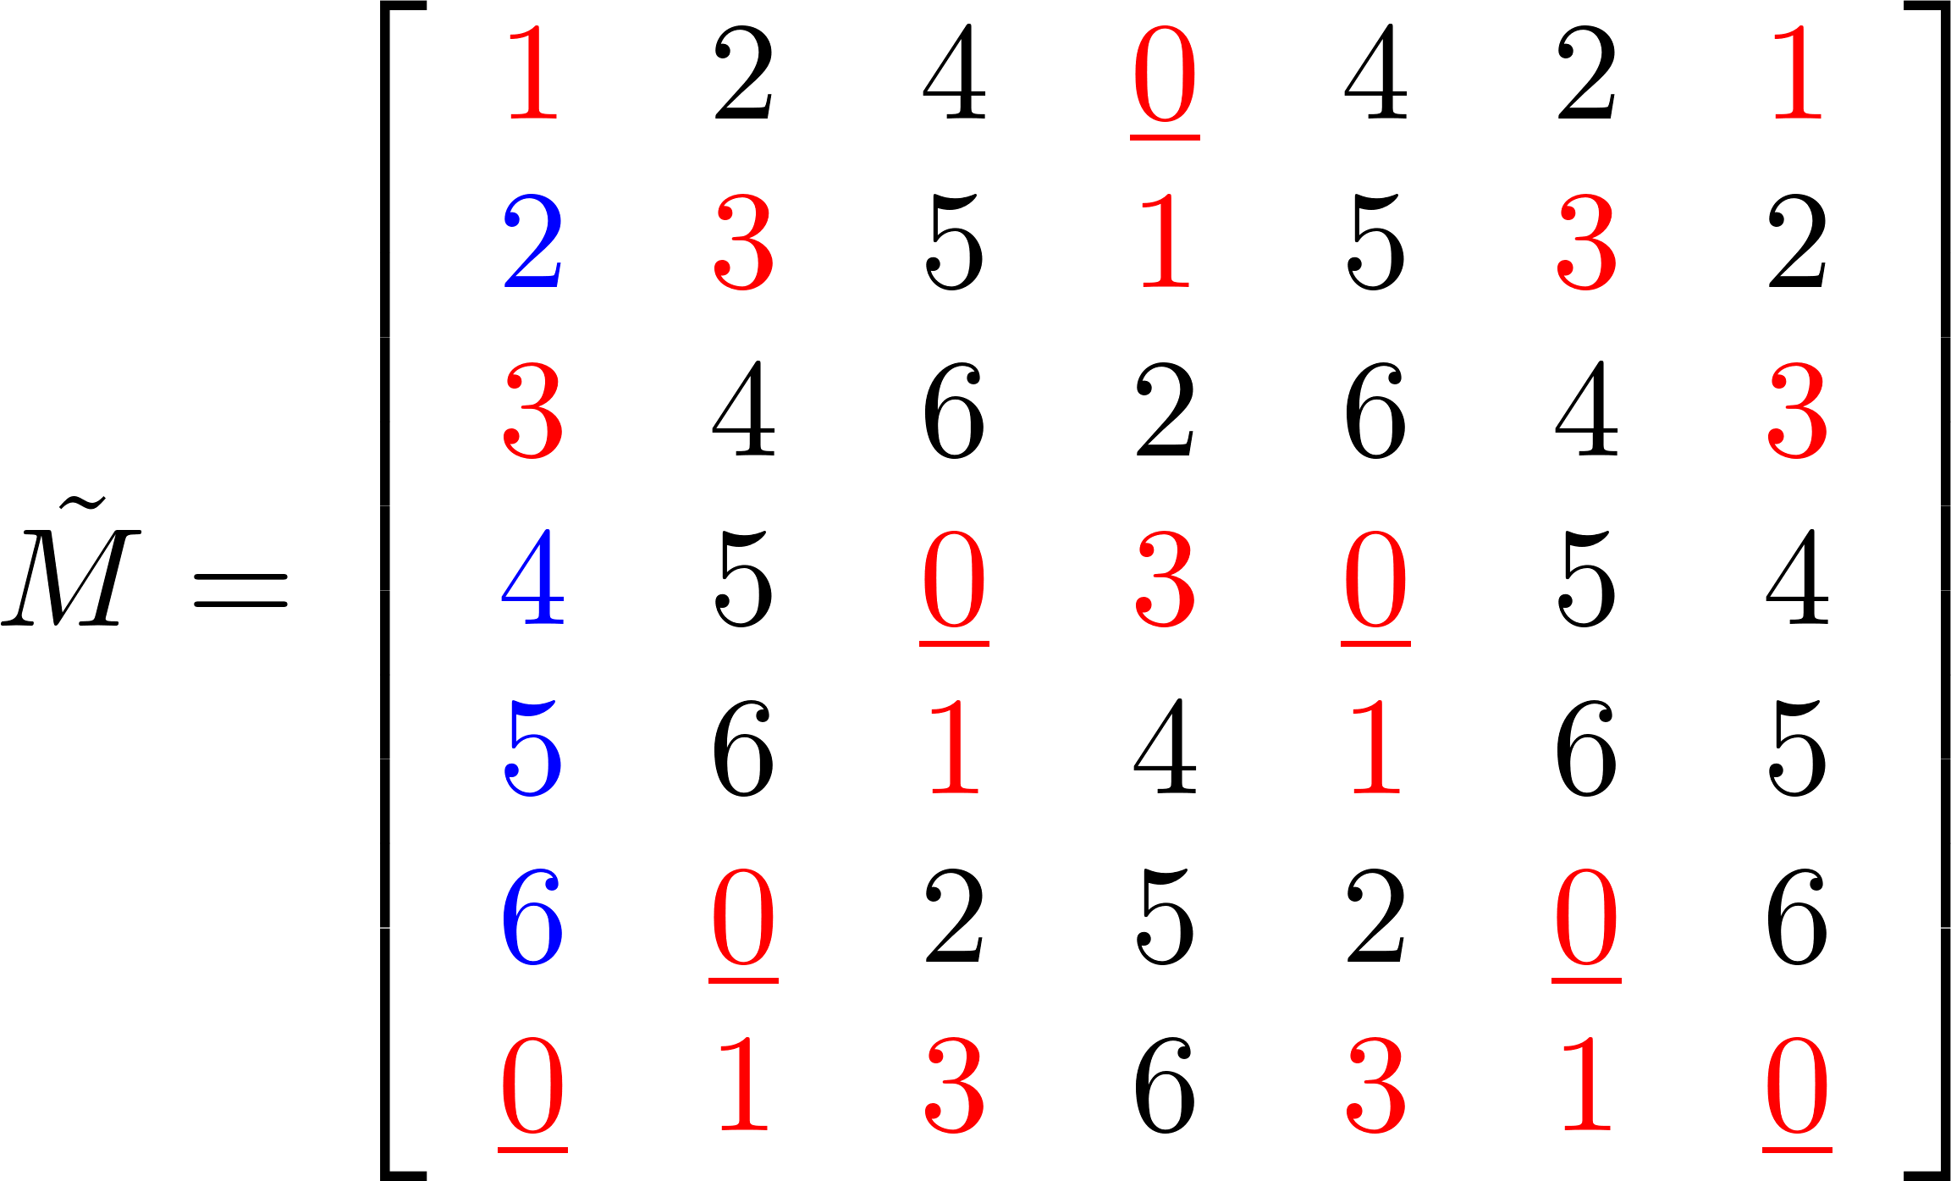
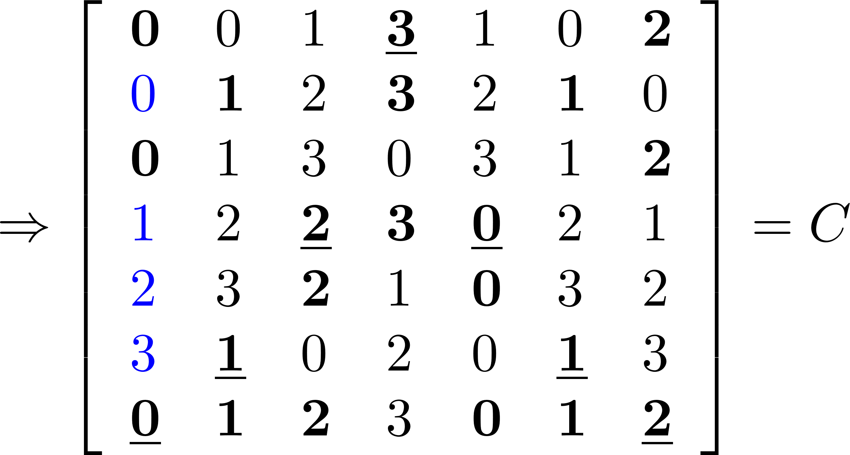
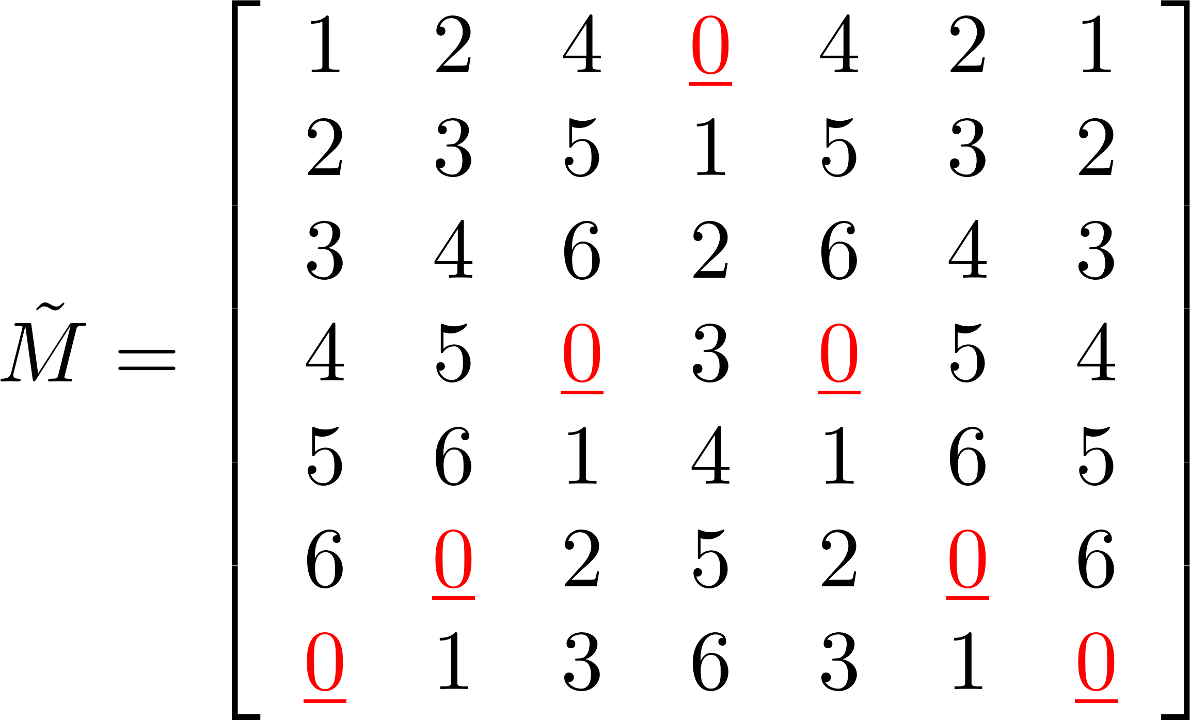
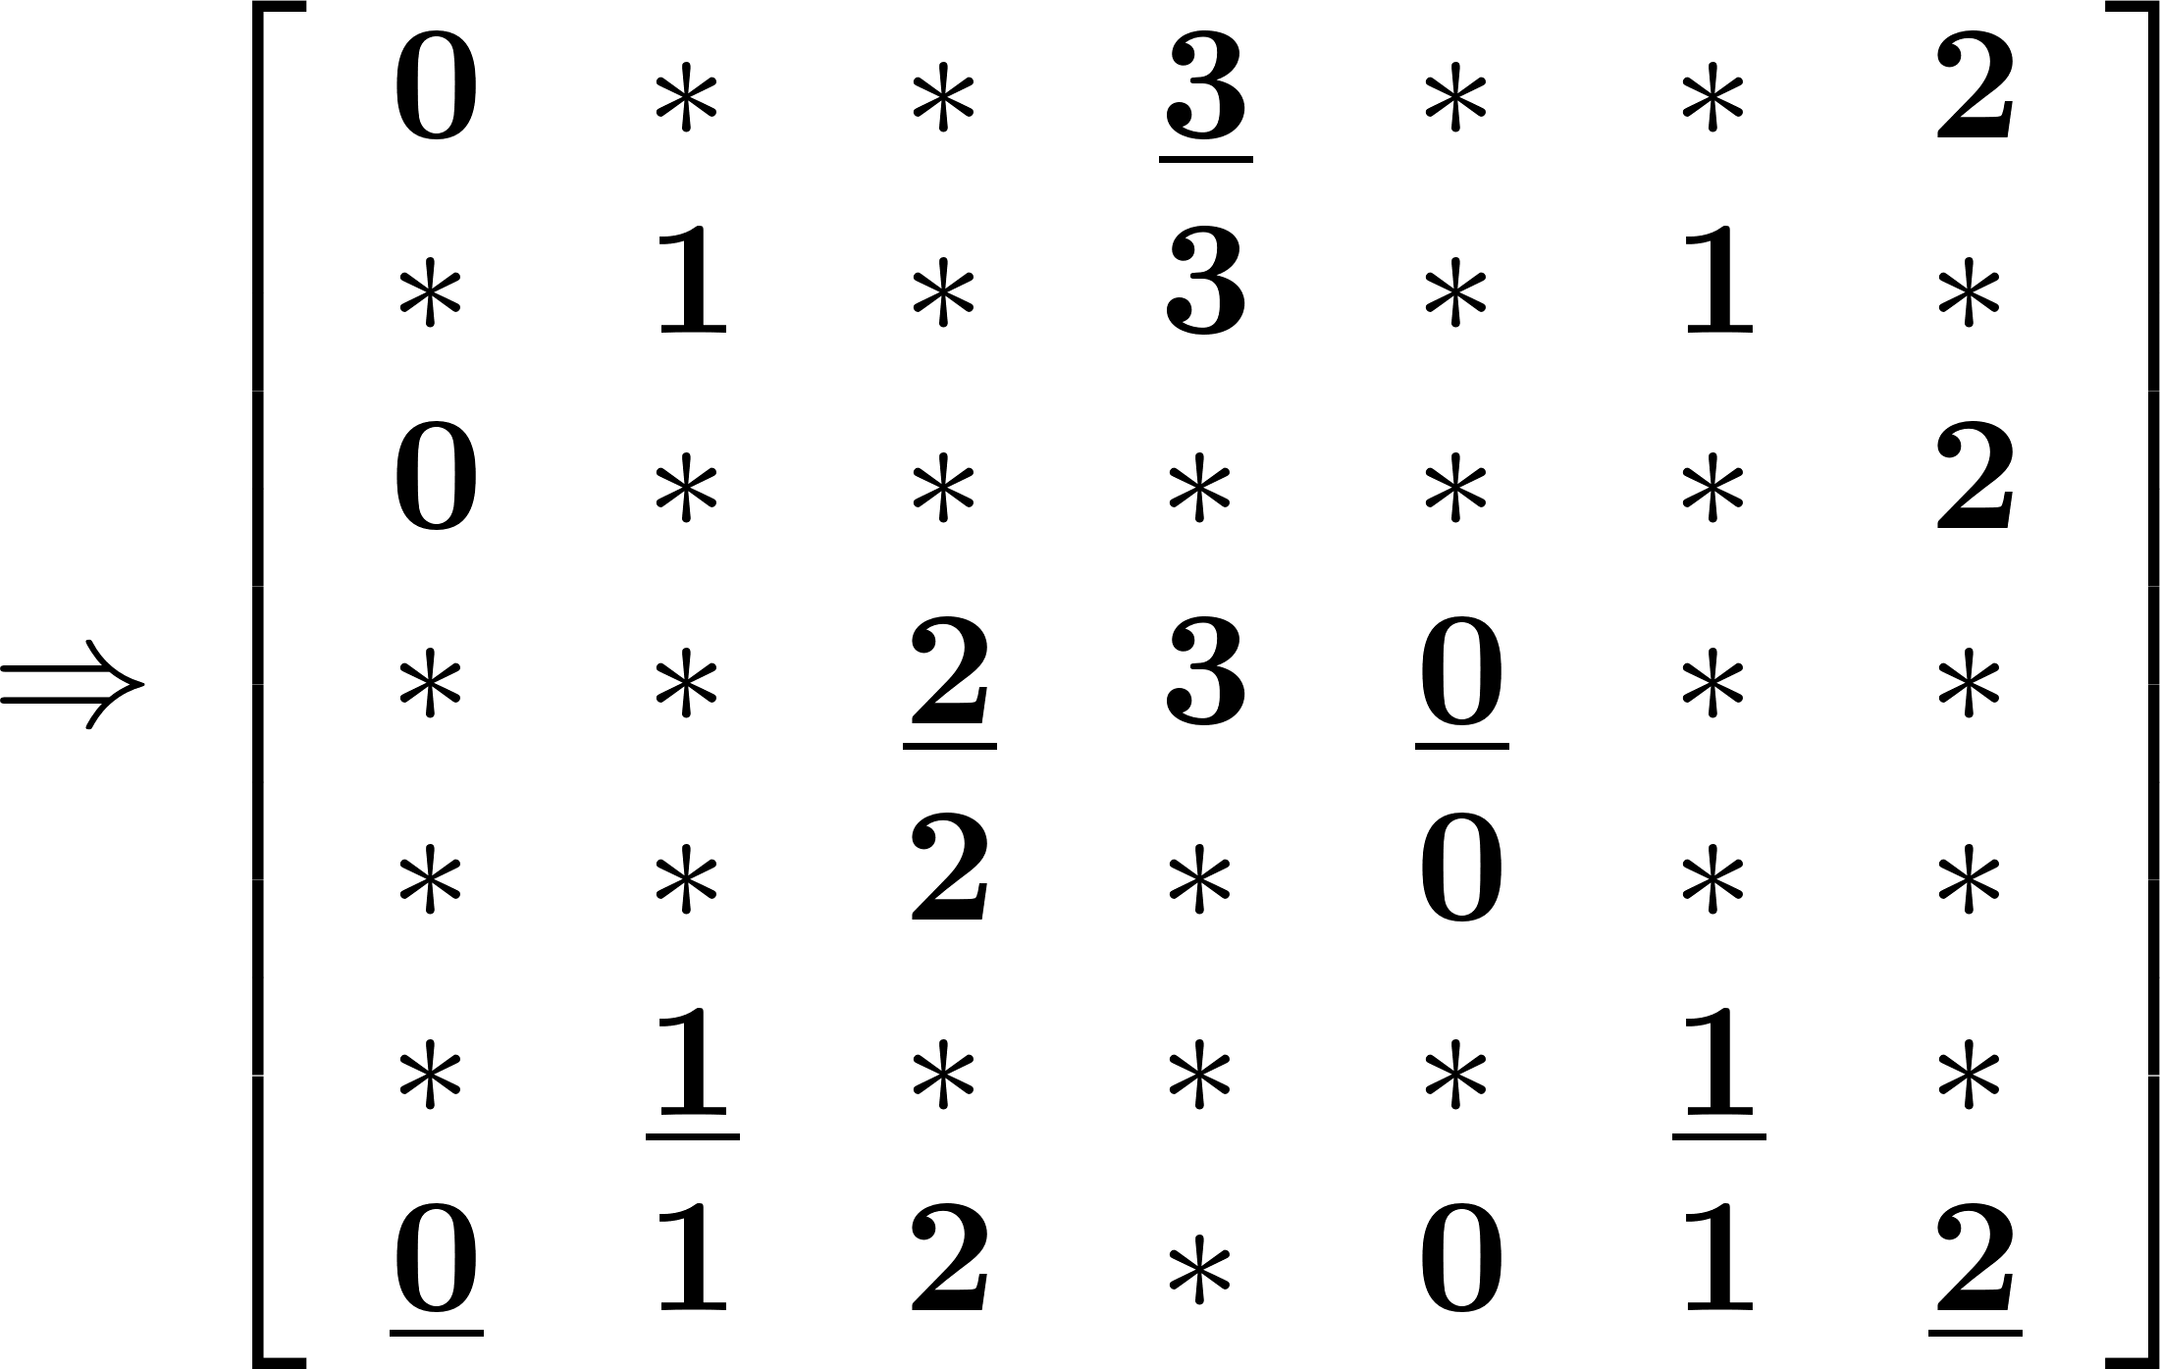
From a semi-MACH matrix to an MACH matrix
Example: Construct a matrix by the following rule:

Slide 43
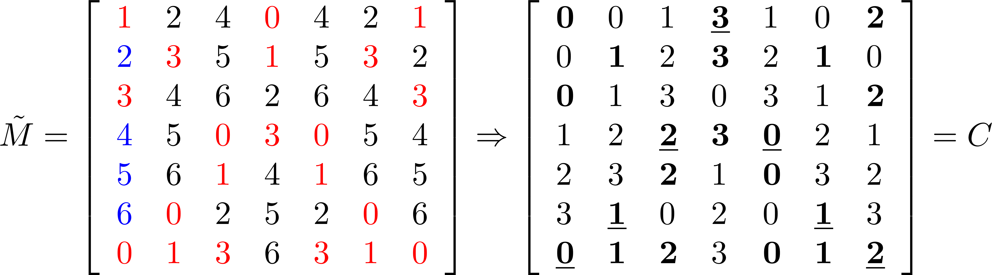

Slide 44
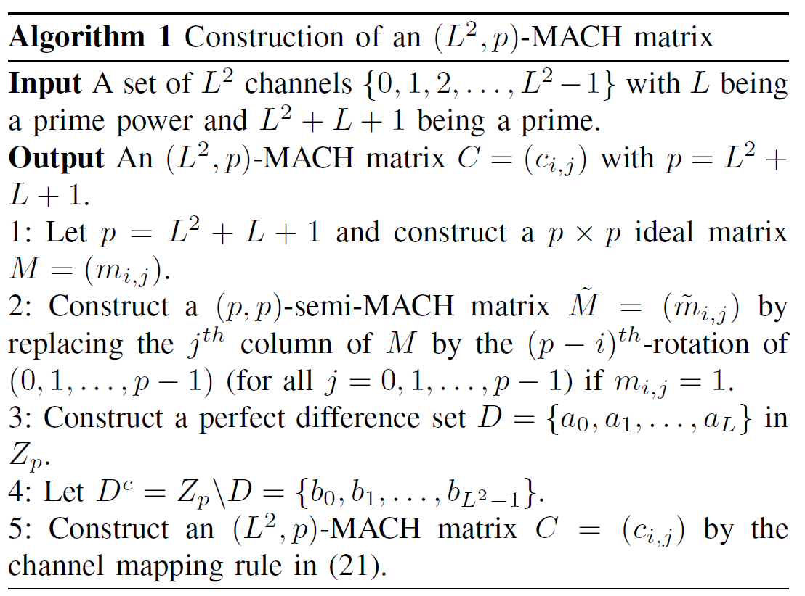

From a semi-MACH matrix to an MACH matrix
Theorem:

Slide 45
IDEAL-CH
MACH sequences and matrices
Difference sets
Ideal matrices
From an ideal matrix to a semi-MACH matrix
From a semi-MACH matrix to an MACH matrix
From an MACH matrix to an MACH sequence

Slide 46







From an MACH matrix to an MACH sequence
We construct an MACH sequence from an
MACH matrix.
The idea to take an MACH matrix and concatenate two of them to form a matrix
Map the matrix to the CH sequence
by letting with
and

Slide 47


From an MACH matrix to an MACH sequence
Example:
The constructed CH sequence with length 98 is then

Slide 48



From an MACH matrix to an MACH sequence
Theorem:

Slide 49


IDEAL-CH
Corollary:

Slide 50



IDEAL-CH (Summary)
If p is a prime and is equal to for some prime power L, our IDEAL-CH can guarantee rendezvous channels within the period
The asymptotic approximation ratio is
and it approaches 2 when
Ideal matrix
semi-MACH matrix
MACH matrix
MACH sequence

Slide 51
Some other well-known MACH sequences
CRSEQ 2010: (N, N(3N-1))-MACH sequence
DRDS 2013: (N, 3N²)-MACH sequence
T-CH 2015: (N, 2.5N²)-MACH sequence
DSCR 2016: (N, 2.5N²)-MACH sequence
All these algorithms are based on ideal matrices. Instead of embedding relaxed difference sets in IDEAL-CH to solve the vertical shift problem, they added an NxN stay matrix.

Slide 52
RDSML-CH is asymptotically optimal
Y. -H. Wang, G. -C. Yang and W. C. Kwong, "Asynchronous Channel-Hopping Sequences With Maximum Rendezvous Diversity and Asymptotic Optimal Period for Cognitive-Radio Wireless Networks," in IEEE Transactions on Communications, vol. 70, no. 9, pp. 5853-5866, Sept. 2022.
G. Gong and H.-Y. Song, “Two-tuple balance of non-binary sequences with ideal two-level autocorrelation,” Discrete Appl. Math., vol. 154, no. 18, pp. 2590–2598, 2006.
R. Paul, Y. Choi, J. Jang, and Y. Kim, “Channel hopping using p-ary m-sequence for rendezvous in cognitive radio networks,” IEEE Wireless Commun. Lett., vol. 8, no. 6, pp. 1516–1519, Dec. 2019.

Slide 53

Maximum-length sequence

Slide 54

Maximum-length sequence

Slide 55


Slide 56

Array Structure

Slide 57

Matrix form of the maximum-length sequence

Slide 58

An example with p=11

Slide 59

Rotation property

Slide 60

Maximum Rendezvous (Non-vertical Shifts)

Slide 61

Construction of RDSML-CH

Slide 62
An ML-sequence with p=11

Slide 63

Replace the column with zeros by a nonzero column

Slide 64

Emdedding an RDS

